Slide 1
Heart Disease Predictions Using Machine Learning
Harsh Bolakani
Greg Morgan
Trevor Pawlewicz

Slide 2
Mission Statement
Our goal for the project is to approach heart disease and compare different classification algorithms on a Heart Failure Prediction Dataset to predict and compare which one does well. We will also compare our algorithms with a neural network to see if does any better.
Our predictions will have a substantial impact on detecting early identification of heart disease. This important because it can provide treatment, increase life expectancy, prevent disability and costly hospitalizations while improving the quality of life.
Loss of heart function is irreversible. Once the damage has been done, a person cannot return to having a fully functional heart. Early detection is key.

Slide 3
Research Aim
Cardiovascular diseases (CVDs) are the number 1 cause of death globally, taking an estimated 17.9 million lives each year, which accounts for 31% of all deaths worldwide. Four out of 5 CVD deaths are due to heart attacks or strokes, and one-third of these deaths occur prematurely in people under 70 years of age. Heart failure is a common event caused by CVDs and this dataset contains 11 features that can be used to predict heart disease.
People with cardiovascular disease or who are at high cardiovascular risk (due to the presence of one or more risk factors such as hypertension, diabetes, hyperlipidemia or already established disease) need early detection and management wherein a machine learning model can be of great help.

Slide 4
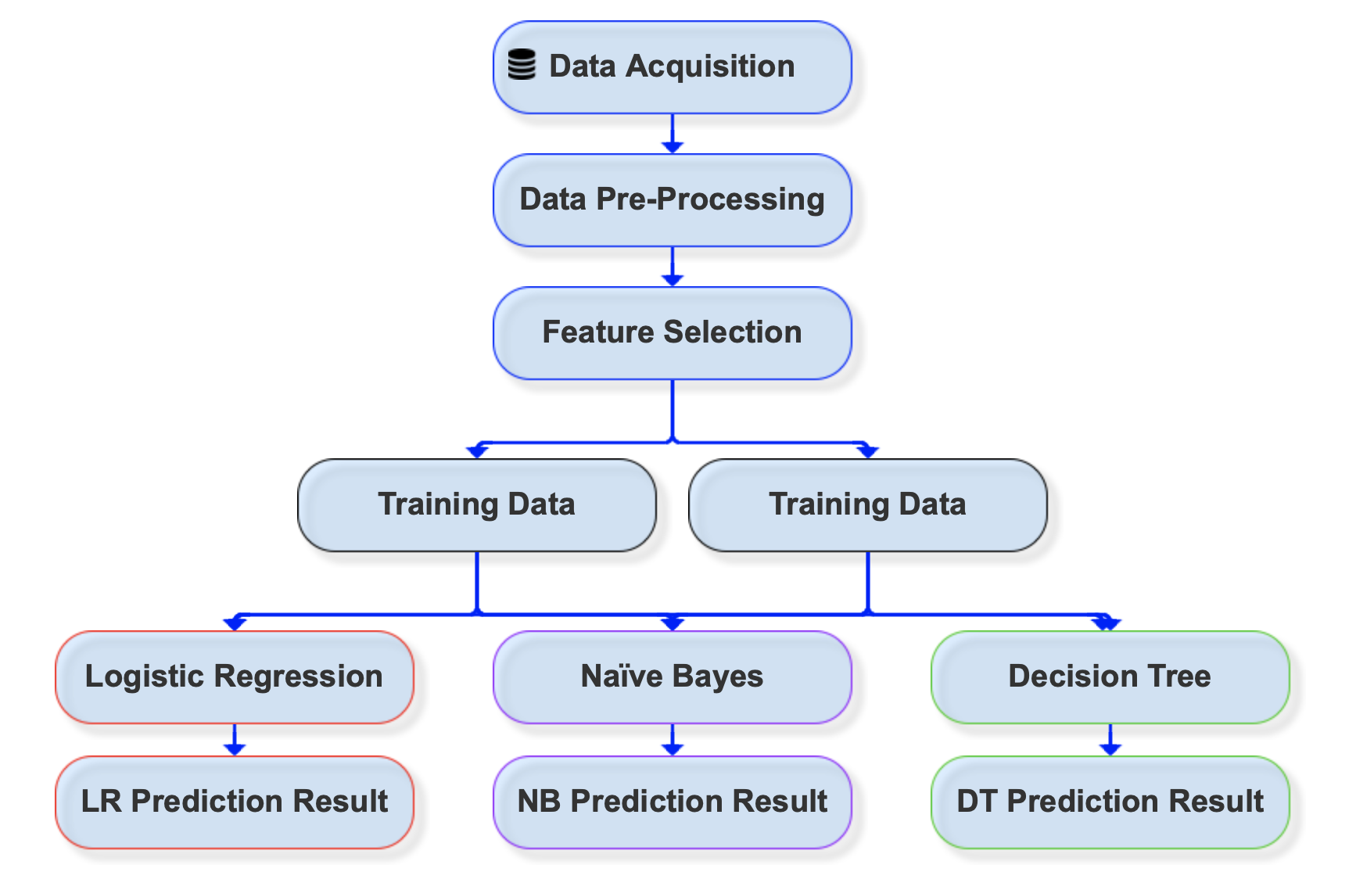
Basic Approach
The manufacturing process models are done with the following steps: data collecting, pre-processing, model building, comparison of models, and evaluation.
Exploratory Data Analysis
Data Processing
Applying algorithms to train a model:
Logistic Regression
Naive Bayes
Decision Tree/Random Forest
Prediction Results
Additional analysis:
Neural Network comparison

Slide 5
Basic Approach:
Logistic regression is a statistical modeling technique used to predict the probability of a binary outcome based on one or more independent variables. The goal of logistic regression is to estimate the probability of the "success" outcome given the values of the independent variables.
Naïve Bayes classifiers are a type of probabilistic machine learning model that calculate the probability of a given instance belonging to a particular class based on the probabilities of its features. It assumes that all features are conditionally independent of each other given the class label.
A decision tree is a supervised machine learning algorithm that can be used for both classification and regression tasks. Decision trees have several advantages, including their interpretability, ability to handle both numerical and categorical features, and their capability to capture non-linear relationships and interactions among features.

Slide 6
Neural Network approach:
The Neural network approach can be used for classification when the labels are not linearly separable. In the context of Heart Disease prediction, we wanted to compare the performance of a neural network model vs other classification models like Logistic regression, Naïve Bayes and decision trees and find whether Neural network performs better or worse than other classification algorithms.
A feedforward network works by first doing a forward pass on the input data through all the artificial neurons using the current weights and an activation function (like Relu, Sigmoid etc)
Then the network minimizes the cost by adjusting the weights using back propagation on all the layers to learn the model

Slide 7

Source of Data: Kaggle
The Heart Failure Prediction Dataset dataset was created by combining different datasets already available independently but not combined before. In this dataset, 5 heart datasets are combined over 11 common features which makes it the largest heart disease dataset available so far for research purposes. The five datasets used for its curation are:
Cleveland: 303 observations
Hungarian: 294 observations
Switzerland: 123 observations
Long Beach VA: 200 observations
Stalog (Heart) Data Set: 270 observations
Every dataset used can be found under the Index of heart disease datasets from UCI Machine Learning Repository on the following link: https://archive.ics.uci.edu/ml/machine-learning-databases/heart-disease/
https://www.kaggle.com/datasets/fedesoriano/heart-failure-prediction

Slide 8
Heart Failure Prediction Dataset structure
Age: age of the patient [years]
Sex: sex of the patient [M: Male, F: Female]
ChestPainType: chest pain type [TA: Typical Angina, ATA: Atypical Angina, NAP: Non-Anginal Pain, ASY: Asymptomatic]
RestingBP: resting blood pressure [mm Hg]
Cholesterol: serum cholesterol [mm/dl]
FastingBS: fasting blood sugar [1: if FastingBS > 120 mg/dl, 0: otherwise]
RestingECG: resting electrocardiogram results [Normal: Normal, ST: having ST-T wave abnormality (T wave inversions and/or ST elevation or depression of > 0.05 mV), LVH: showing probable or definite left ventricular hypertrophy by Estes' criteria]
MaxHR: maximum heart rate achieved [Numeric value between 60 and 202]
ExerciseAngina: exercise-induced angina [Y: Yes, N: No]
Oldpeak: oldpeak = ST [Numeric value measured in depression]
ST_Slope: the slope of the peak exercise ST segment [Up: upsloping, Flat: flat, Down: downsloping]
HeartDisease: output class [1: heart disease, 0: Normal]

Slide 9
Exploratory Data Analysis
Before training our models, we need to observe and analyze the data to see what we are going to work with. The goal here is to learn more about the data and become a topic export on the dataset you are working with.
This data set includes a patient's medical data(resting heart rate, cholesterol levels, blood pressure, blood sugar levels, etc.). Our Goal in this section is to determine factors that contribute to heart failure and find correlation of various factors.

Slide 10
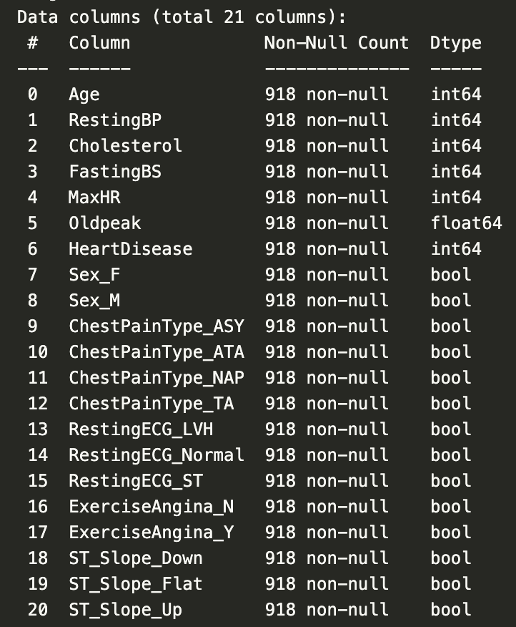
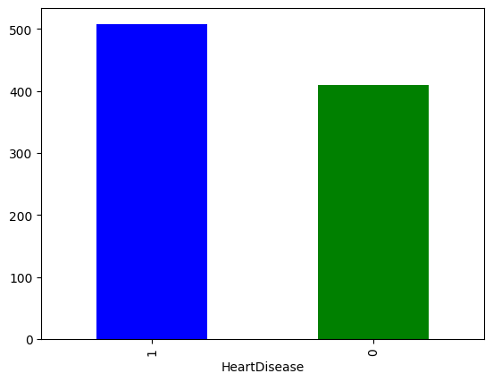
Exploratory Data Analysis
We have 508 people with heart disease and 410 people without heart disease, so our problem is balanced.
This dataset looks perfect to use as we don’t have null values.

Slide 11
Results and Observations
Neural Network
Experiment
In our experiment, we chose the PyTorch library to build a neural network for this classification task. The motivation was to use an available deep learning library that provides various optimizers and loss functions and an easy way to tune hyperparameters so we can arrive at the most accurate network. In this experiment we found that a neural network with 2 layers performed best with our data set of heart data. we ran the experiment with 8 -14 neurons in the first layer and 2 neurons in the final layer with the LeakyReLU activation to predict the chances of heart failure.
Observation
We were able to achieve a top accuracy of 86% over the test data with 12 neurons in the first layer and with optimizer set as RMSProp.

Slide 12
Future extensions of your work
A few words…

Slide 13
Our Dataset Issues and Limitations
A few words…

Slide 14
Related Work and Basis of Project
https://thecleverprogrammer.com/2020/11/10/heart-disease-prediction-using-machine-learning/
https://www.kaggle.com/datasets/fedesoriano/heart-failure-prediction

Slide 15
Team and Contributions
Harsh Bolakani
Greg Morgan
Trevor Pawlewicz

Slide 16
Thank You

Slide 17
Appendix

Slide 18
Logistic Regression approach:
One of the simplest and best ML classification algorithm is Logistic Regression. The LR is the supervised ML binary classification algorithm widely used in most application. It works on categorical dependent variable the result can be discrete or binary categorical variable 0 or 1.
The sigmoid function is used as a cost function. Sigmoid function maps a predicted real value to a probabilistic value between ‘0’ and ‘1’.

Slide 19
Naive Bayes approach:
Naive Bayes classifier is a statistical based classifier which is based on Bayes Theory. It assumes that attributes are statistically independent. This classifier is based on probabilities. Given two events A and B, P (A) is prior probability and P (A|B) is posterior probability, then according to Bayes theorem.
P (A|B) = P (B/A) P (A)/P (B) and
P (B|A) is computed as P (A ∩ B) = P (A)
These Bayesian probabilities are used to determine the most likely next event for the given instance given all the training data. Conditional probabilities are determined from the training data. The Naive Bayes model is based on the conditional independence model of each predictor give the target class. This classifier yields optimal prediction (given the assumptions). It can also handle discrete or numeric attribute values.
Notes:
Naive Bayes is a supervised machine learning probabilistic algorithm that’s typically used for classification problems.
Naive Bayes is simple, intuitive, and yet performs surprisingly well in many cases. It seeks to model the distribution of inputs of a given class or category.
Unlike discriminative classifiers, like logistic regression, it does not learn which features are most important to differentiate between classes.

Slide 20

Decision Tree approach:
The decision tree algorithm is a supervised learning algorithm that can be used in both classification or regression analysis. Unlike linear algorithms, decision trees algorithms are capable of handling nonlinear relationships between variables in the data.
The information gained in the decision tree can be defined as the amount of information improved in the nodes before splitting them for making further decisions.
To measure the information gain we use the entropy. Which is a quantified measurement of the amount of uncertainty because of any process or any given random variable. Mathematically the formula for entropy is:

